Slide 1
MIPS Resources
MARS MIPS simulator – Download and Install
http://courses.missouristate.edu/KenVollmar/MARS/
Dbl click OR run with % java -jar Mars4_5.jar in command window
MIPS Documentation
https://pauldownen.com/courses/23F/Assembly/notes/MIPS_Instruction_Set.pdf
https://inst.eecs.berkeley.edu/~cs61c/resources/MIPS_help.html
MIPS Youtube
https://www.youtube.com/playlist?list=PL5b07qlmA3P6zUdDf-o97ddfpvPFuNa5A

Slide 2
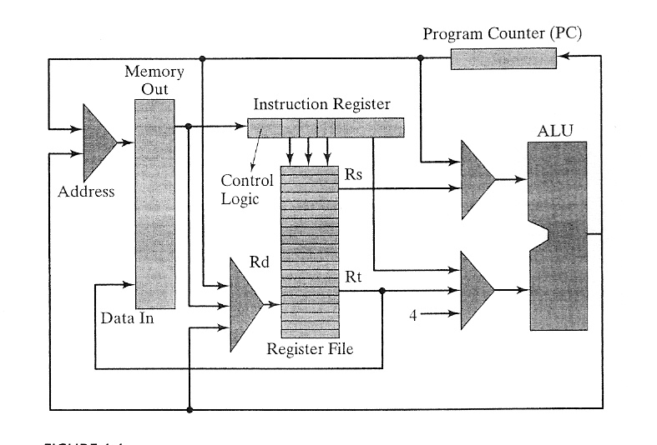
MIPS Architecture
Microprocessor without Interlocked Pipeline Stages
Resources
CPU
ALU
Registers
Memory
I/O
Central Processing Unit
Arithmetic & Logical Unit
CPU

Slide 3
Hardware Organization
Resources
CPU (Central Processing Unit)
ALU (Arithmetic & Logical Unit)
Register File
Program Counter (PC)
Instruction Register (IR)
Memory
I/O

Slide 4
Program Execution
Hello program
Compile
gcc –o hello hello.c
./hello
Von Neumann Architecture (1945) – re-use memory
Code Memory
CPU
Registers
Program Code
Instructions
PC
ALU
Addresses
Data Memory
Data
CC
Program Data

Slide 5
Pre-
processor
(cpp)
Compiler
(cc1)
hello.s
Assembler
(as)
Linker
(ld)
hello
hello.c
Source
program
(text)
Assembly
program
(text)
Executable
object
program
(binary)
??
PC (Program Counter)
IP (Instruction Pointer)
Instruction Format, Syntax

Slide 6
Assembly to Machine Code

Slide 7
Assembler: System Software
Assembly program into Executable Machine Code
Assembler

Slide 8
Assembly Programmer’s View
Code Memory
CPU
Instructions
Registers
Program Code
PC
ALU
Addresses
Data Memory
Condition
Codes
Data
Program Data
Programmer-Visible State
Program Counter (PC)
Address of the next instruction
Register File
Heavily used program data
Condition Codes
Store status information about most recent arithmetic operation
Used for conditional branching
Memory
Byte addressable array (organized in words)
Code, user data, OS data
Includes stack

Slide 9
How to use Resources ?
Code Memory
CPU
Instructions
Registers
Program Code
PC
ALU
Addresses
Data Memory
Condition
Codes
Data
Program Data
Data transfer
From memory to register: load
From register to memory: store
Operator
Add, sub, mul, etc.
Input/Output

Slide 10
Assembly Characteristics
Minimal Data Types
“Integer” data of 1, 2, or 4 bytes
Data values
Addresses (untyped pointers)
Floating point data of 4, 8, or 10 bytes
No aggregate types such as arrays or structures
Just contiguously allocated bytes in memory
Primitive Operations
Perform arithmetic function on register or memory data
Transfer data between memory and register
Load data from memory into register
Store register data into memory
Transfer control
Unconditional jumps to/from procedures
Conditional branches

Slide 11
Assembly Instruction
label: instruction operand {,operand} #comments
label – a place holder: address
Instruction – operation to perform
Operand – source or target of the operation
First operand is a Destination
Except saving from Register to Memory
Register: One of 32 integer registers
Immediate: Constant integer data
0xff for hex constant
Otherwise, decimal
Memory: 4 consecutive bytes of memory
Various “address modes”

Slide 12
Resources
Memory
Code and Data memories
2³² bytes of storage 2¹⁰=1024 (1k)
2³² = 2³⁰x2² = 4B
2⁶⁴ = 2³²x2³² = 16BxB
ALU – perform 32-bit operation
32 32-bit Registers
$zero or $0: always 0, and cannot be modified
$t0 -- $t9 (10): General purpose => temporary
$a0 -- $a3 (4): General purpose => arguments
$s0 -- $s7 (8): General purpose => save
$v0, $v1 (2): General purpose => i/o
$sp (1): stack pointer
$ra (1): return address

Slide 13
reg1 = 0
reg9 = 0
rept: reg3 = grades[reg9]
compare(reg3, 0)
branch(LT) to next
add reg1, reg1, reg3
add reg9, 1, reg9
goto rept
next:
compare(reg9,0)
branch(LE) to done
reg3 = reg1/reg9
print reg3
goto Exit
done:
print 'no grades were entered'
Exit:
reg1 = 0
reg9 = 0
rept:
If (grades[reg9]<0) goto next
add reg1, reg1, grades[reg9]
add reg9, 1, reg9
goto rept
next:
if (reg9 <= 0) goto done
average = reg1/reg9
print average
goto Exit
done:
print 'no grades were entered'
Exit:

Slide 14
li $t1, 0
li $t9, 0
rept: mul $t8, $t9, 4
lw $t3, grades($t8)
blt $t3, 0, next
add $t1, $t1, $t3
addi $t9, $t9, 1
b rept
next:
ble $t9, 0, done
blez $t9, done
div $t3, $t1, $t9
print $t3
b Exit
done:
print 'no grades were entered'
Exit:
reg1 = 0
reg9 = 0
rept: reg3 = grades[reg9]
compare(reg3, 0)
branch(LT) to next
add reg1, reg1, reg3
add reg9, 1, reg9
goto rept
next:
compare(reg9,0)
branch(LE) to done
reg3 = reg1/reg9
print reg3
goto Exit
done:
print 'no grades were entered'
Exit:

